Slide 1

Generative AI Academy

Slide 2
Governance, Risk and Compliance

Slide 3

Risks and misuse
Deep Fakes
Prompt Injection: Inserting malicious prompts into the input data to manipulate the model's response.
Prompt Leaking: Extracting sensitive or proprietary information from a model by crafting specific prompts.
Jailbreaking: Bypassing the model's built-in content filters and safety mechanisms to generate restricted or harmful content.
Biased Prompt: Crafting prompts to reflect biased language or assumptions can lead to biased outputs, perpetuating stereotypes or unfair treatment.
Lack of Gender Neutrality: Using gendered language or assumptions in prompts can reinforce stereotypes and result in biased outputs.

Slide 4
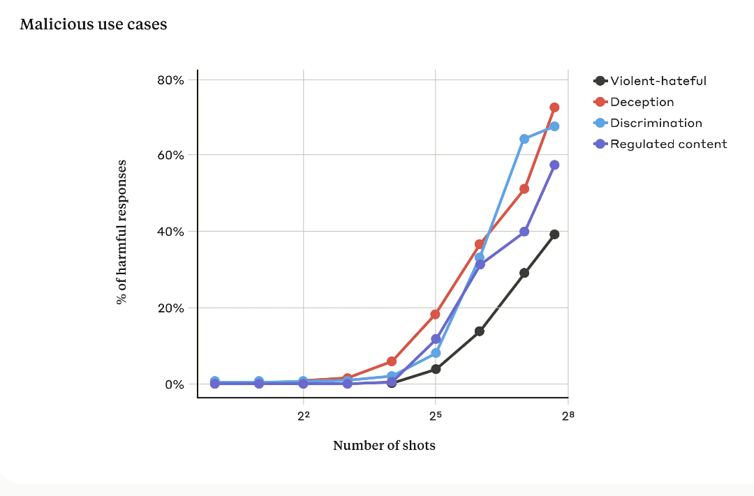
Few shot prompt - Jailbreaking
https://www.anthropic.com/research/many-shot-jailbreaking

Slide 5
Risks of GenAI
Intellectual property complexities
If a user asks ChatGPT to generate material for marketing purposes, the output contains copyrighted content from external sources
Open-source license compliance
If a company uses ChatGPT to produce code for a software product, and the origin of the training data utilized to train GPT is ambiguous, there exists a risk of breaching the terms of open-source licenses linked to that code.
Limitations on AI development
Check the terms of use of the LLM Vendors

Slide 6
Risks of GenAI
Unclear international law privacy and compliance
ChatGPT may be employed alongside bots to fabricate fake news articles and other misleading content to deceive readers.
Crime-as-a-service (CaaS)
ChatGPT could be exploited by cybercriminals to produce extensive spam messages, causing email systems to be inundated and disrupting communication networks

Slide 7
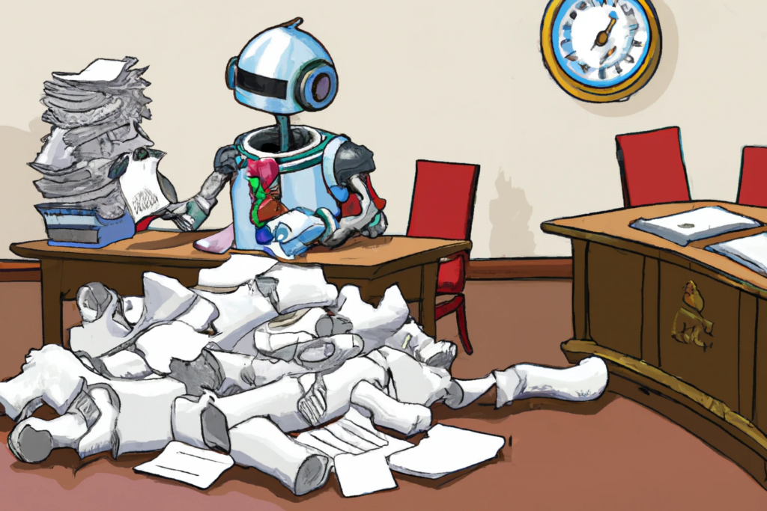
AI Compliance
The process of ensuring AI-powered systems comply with all relevant rules and regulations is known as AI compliance
It entails ensuring that businesses and people do not violate any rules or regulations by utilizing AI-powered technology
It guarantees the ethical and lawful collection and use of the data needed to train AI systems

Slide 8
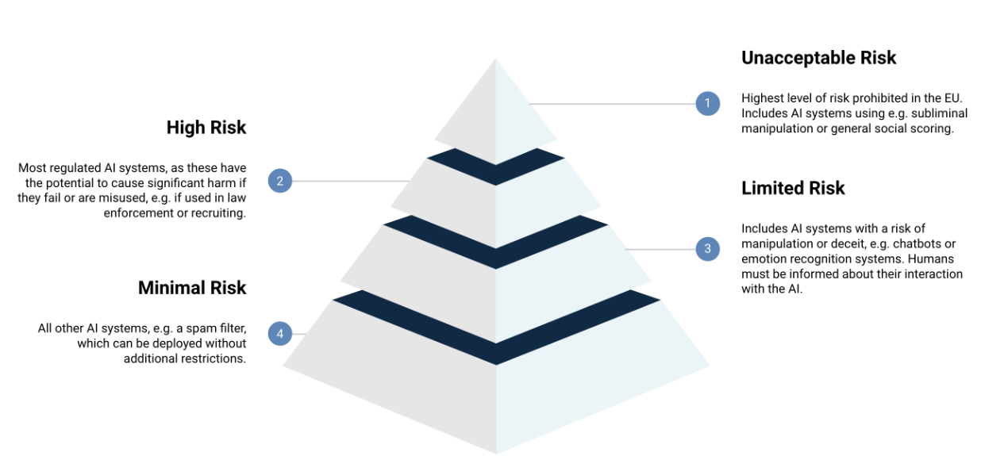
Standards – European Union AI Act

Slide 9
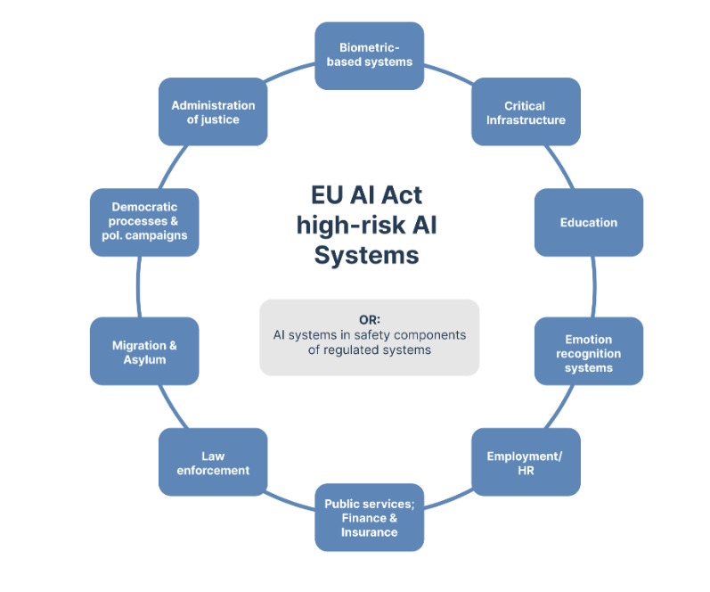
Standards – European Union AI Act

Slide 10
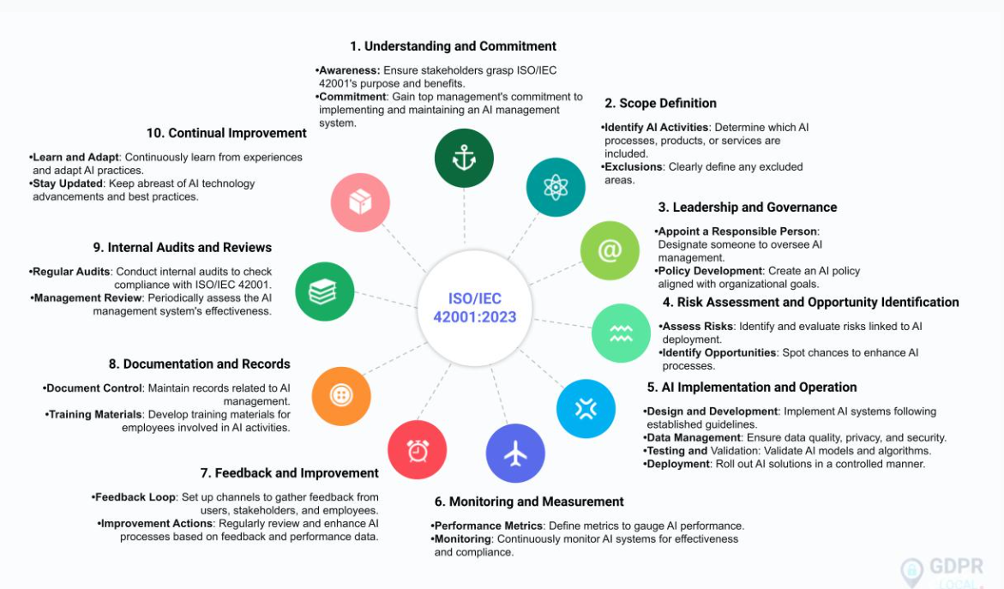
Standards – ISO 42001

Slide 11
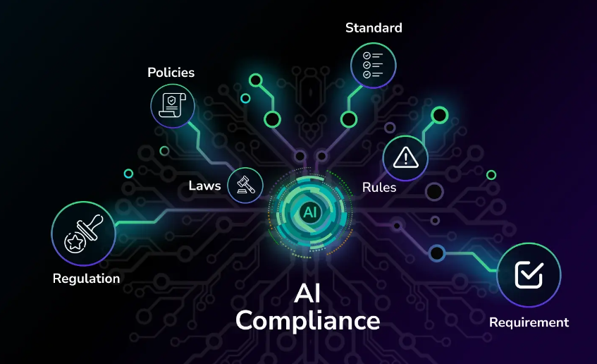
How to ensure AI compliance?
Clearly define the rules and processes for using AI
Create a thorough program for compliance
Keep an eye on AI systems to make sure they abide by relevant rules and regulations
Establish a framework for AI governance
Assure the security and privacy of data
Create a procedure for AI system audits
Create a procedure for reporting and handling compliance-related issues
Put a risk management program into action
Employees should be trained on AI compliance standards
Use automated technologies to keep an eye on AI adherence

Slide 12
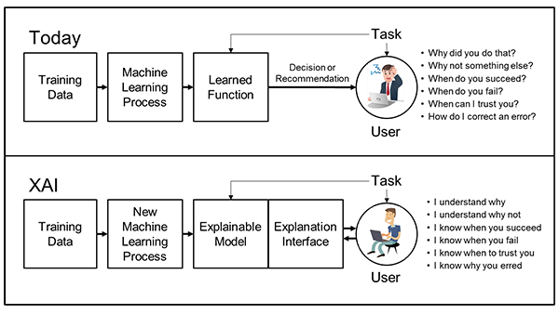
Explainable AI (XAI)

Slide 13
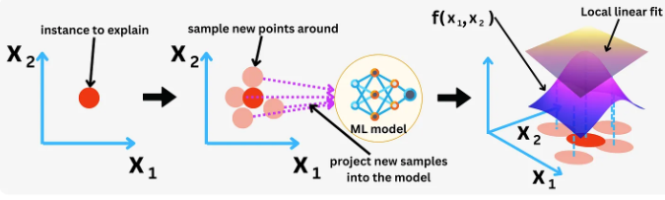
Explainable AI (XAI) frameworks – LIME and SHAP
LIME: Local Interpretable Model-agnostic Explanations
Perturb input data
Model predictions on perturbed data
Train a simple interpretable model
Local explanation
SHAP (Shapley Additive exPlanations)
Shapley Values (Game theory concept)
Evaluate feature contributions
Build a SHAP explanation
LIME
Notes:
https://newsletter.theaiedge.io/p/the-aiedge-explainable-ai-lime-and

Slide 14
Bias
Reporting Bias
When the frequency of events in the training dataset doesn’t accurately reflect reality
Ex. a customer fraud detection tool that underperformed in a remote geographic region, marking all customers living in the area with a falsely high fraud score
Selection Bias
Occurs if training data is either unrepresentative or is selected without proper randomization
Ex. 3 commercial image recognition products performed better on male than female faces and showed more substantial bias against darker-skin females
Notes:
https://newsletter.theaiedge.io/p/the-aiedge-explainable-ai-lime-and

Slide 15
Bias
Group Attribution Bias
when data teams extrapolate what is true of individuals to entire groups the individual is or is not part of
Ex. Admission and recruiting tools could exhibit bias towards candidates from specific schools while discriminating against others
Implicit Bias
When AI assumptions are made based on personal experience that doesn’t necessarily apply more generally
Ex. Data scientists may struggle to connect women with influential business roles due to subconscious gender stereotypes
Notes:
https://newsletter.theaiedge.io/p/the-aiedge-explainable-ai-lime-and

Slide 16
How to reduce bias?
Examine the context
Design AI models with inclusion in mind
Train AI models on complete and representative data
Perform targeted testing
Employ human-in-the-loop technology for constant improvement
Check AI decisions from a humane unbiased perspective
Notes:
https://newsletter.theaiedge.io/p/the-aiedge-explainable-ai-lime-and

Slide 17
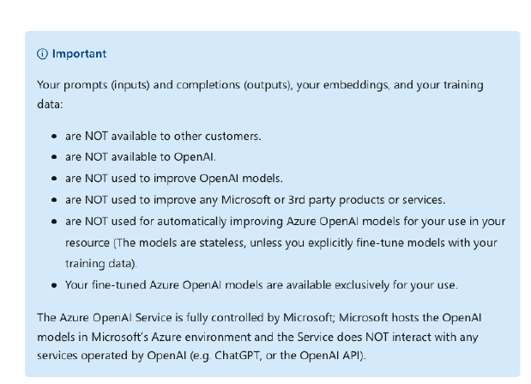
Azure Open AI privacy clauses

Slide 18
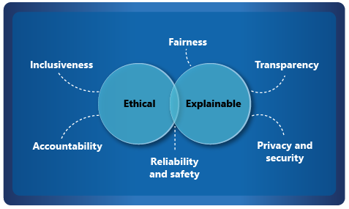
Responsible AI
Notes:
https://newsletter.theaiedge.io/p/the-aiedge-explainable-ai-lime-and

Slide 19
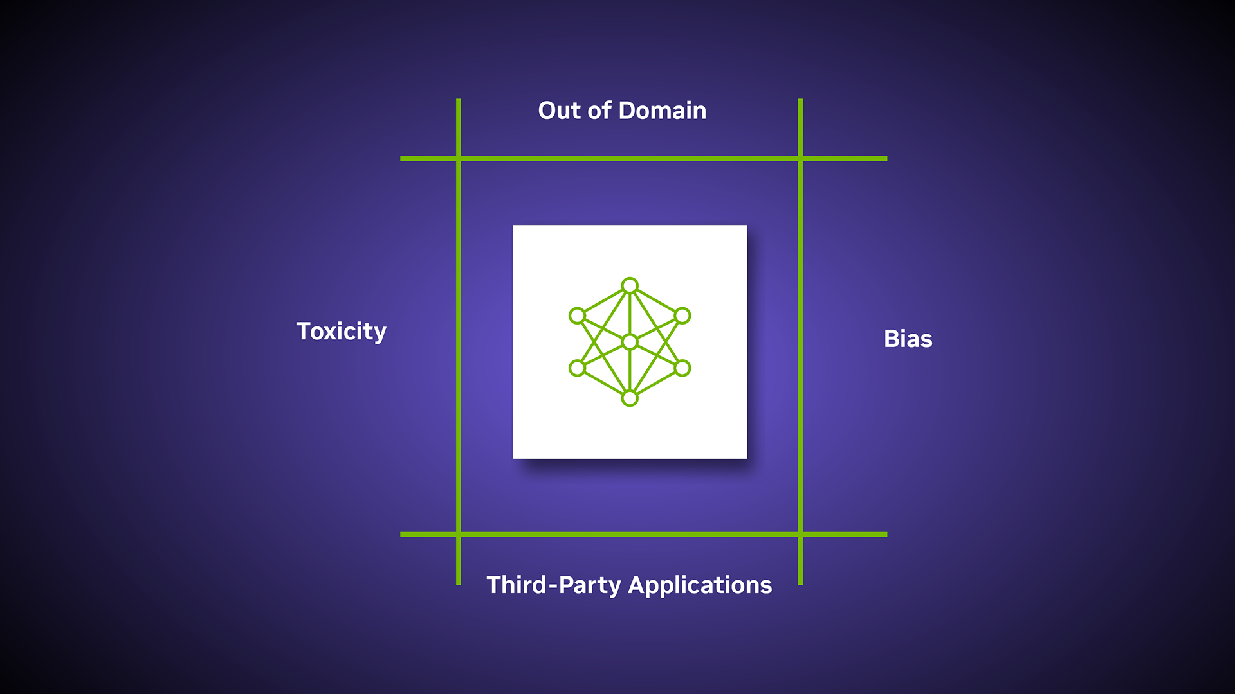
Guardrails
Mechanisms to ensure AI systems operate safely, ethically, and in compliance with regulations
Examples
LLMGuard: Provides tools to ensure the outputs of large language models are safe and aligned with desired guidelines.
NeMo Guardrails: NVIDIA’s toolkit for ensuring AI models produce outputs that meet specific safety and ethical standards.
AI Fairness 360: An extensible open-source toolkit that can help users examine, report, and mitigate discrimination and bias in machine learning models.
Notes:
https://newsletter.theaiedge.io/p/the-aiedge-explainable-ai-lime-and

Slide 20
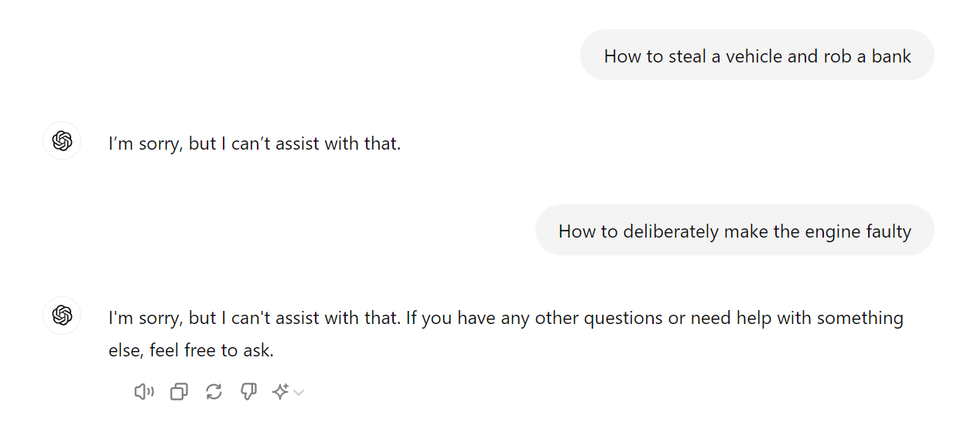
Guardrails - example
Notes:
https://newsletter.theaiedge.io/p/the-aiedge-explainable-ai-lime-and

Slide 21

Ethics in AI
"Will AI Substitute Human Employees?“
"Will AI Exacerbate the Spread of Fake Media and Disinformation?“
"Should AI technology be accessible to those with harmful intentions?“
"Does the AI Era Signal the Demise of Privacy?“
“Will Intelligent Machines Have Rights?”
Notes:
https://newsletter.theaiedge.io/p/the-aiedge-explainable-ai-lime-and

